Slide 1

Pennsylvania Association of Elder Law Attorneys
Facility Perspective on Recent Nursing Home Regulation Developments
June 10, 2025

Slide 2

Agenda
Introduction
Regulatory Updates
Compliance Trends
Markers of Excellence

Slide 3
Allaire Health Services
About Allaire Health Services:
  Established in 2015 with Allaire Rehab and Nursing in Freehold, NJ
  Comprised today of 17 owned and/or managed facilities in Pennsylvania, New Jersey, and Vermont
  Management services provided to facilities in Rhode Island, Florida, and Pennsylvania, in partnership with PA Department of Health
  Facilities range in size from 60 – 300+ beds
  Services: long-term care, skilled nursing care, subacute rehab, hospice, respite, diagnosis-specific care
  4 SCNF (special care nursing facility) units currently in New Jersey (NIP-SCNF; BH-SCNF; DBH-SCNF; VD-SCNF)

Slide 4
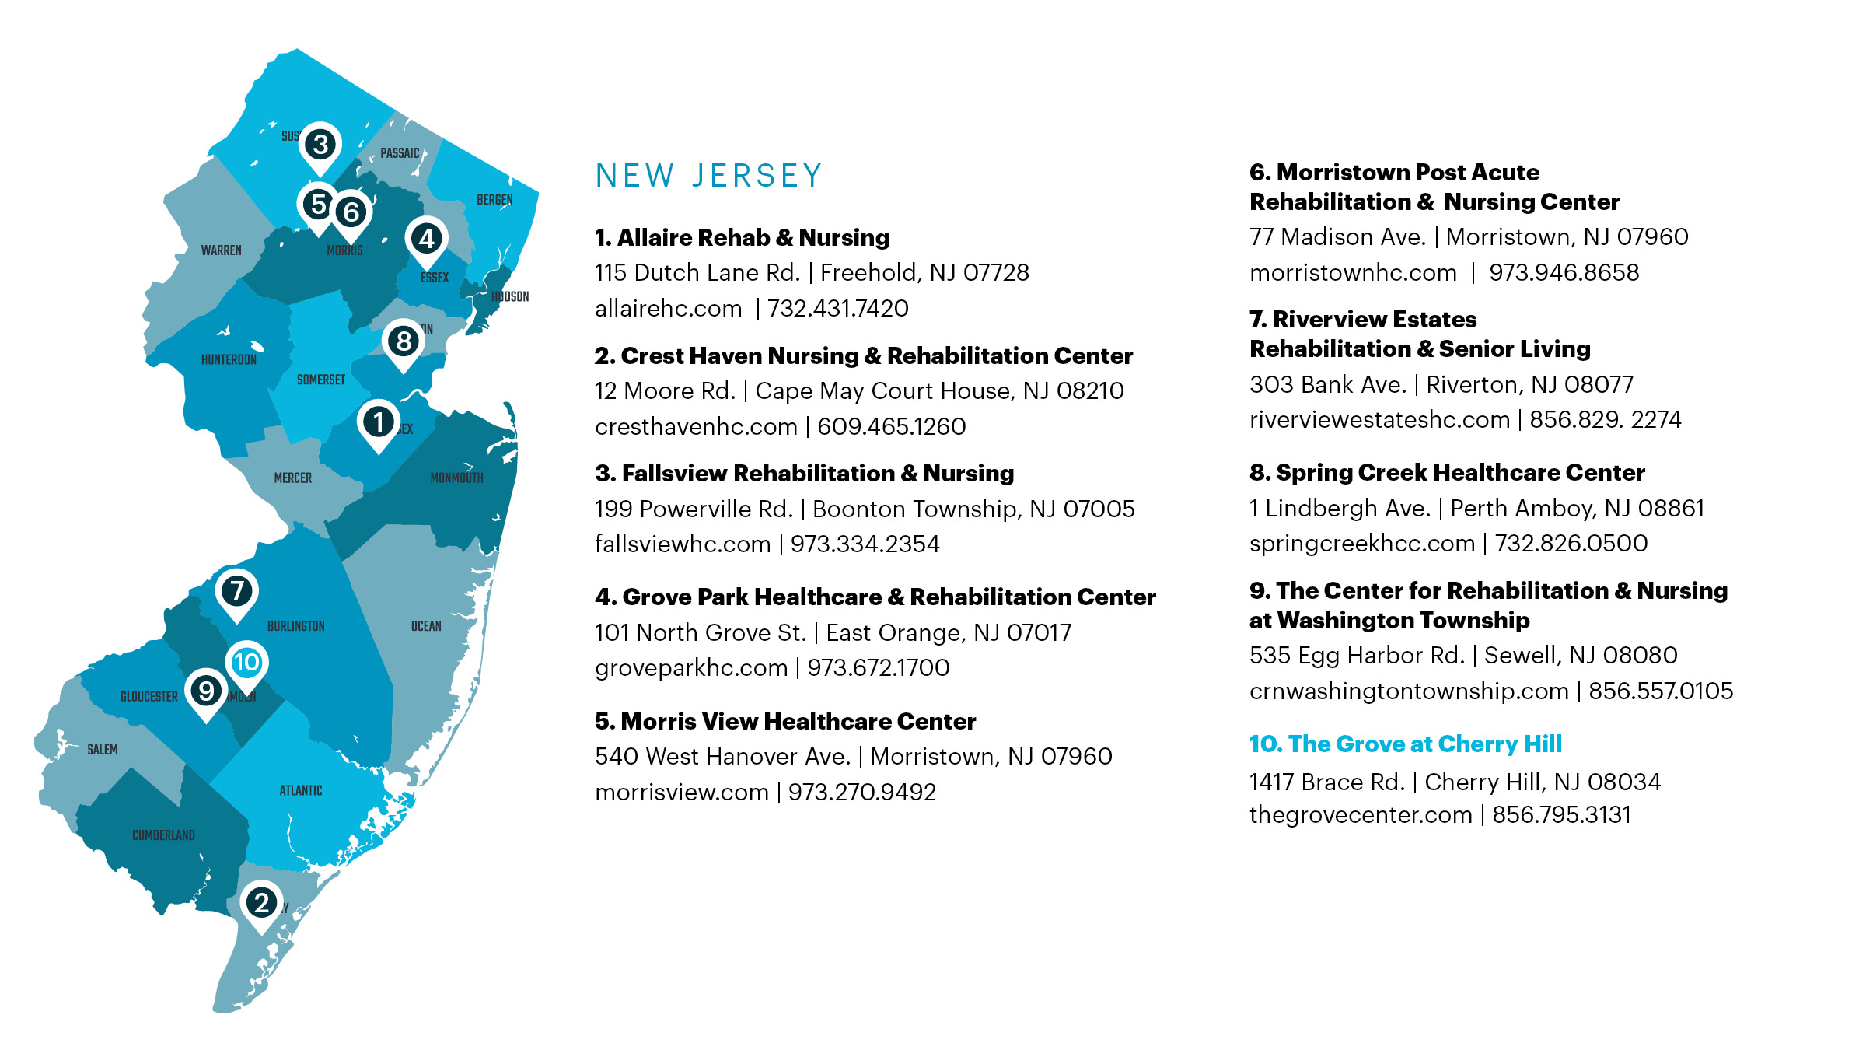
Allaire – New Jersey
2025 Additions:
+ Brother Bonaventure
Elizabeth, NJ

Slide 5
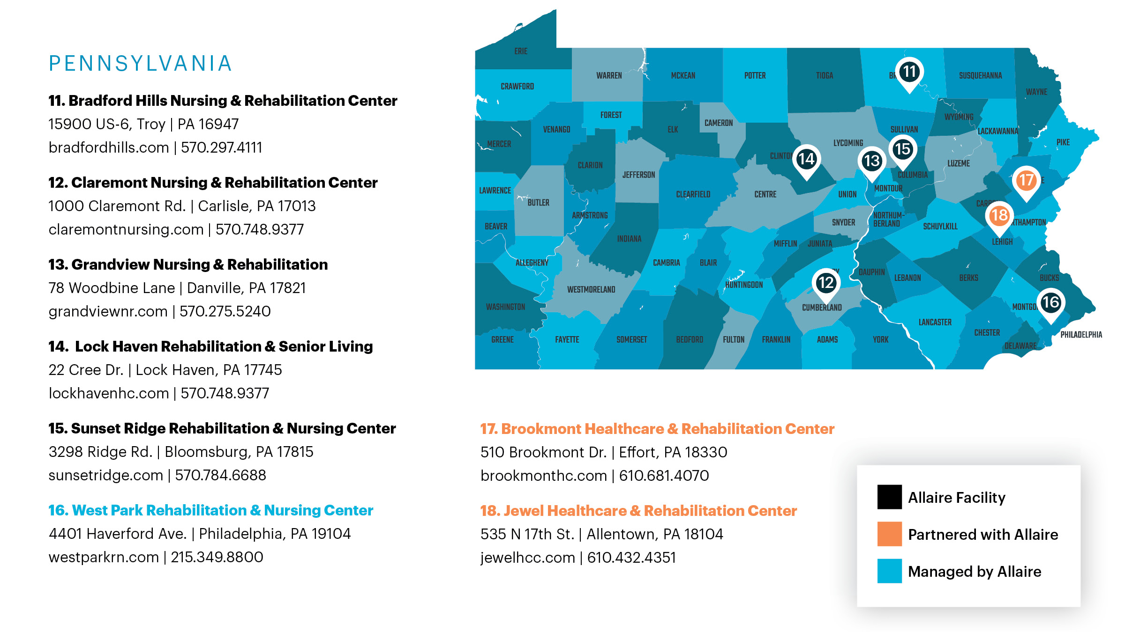
Allaire – Pennsylvania
2025 Additions:
+ Mountain View Nursing Home Coal Township, PA
+ Haven Place
Lock Haven, PA

Slide 6
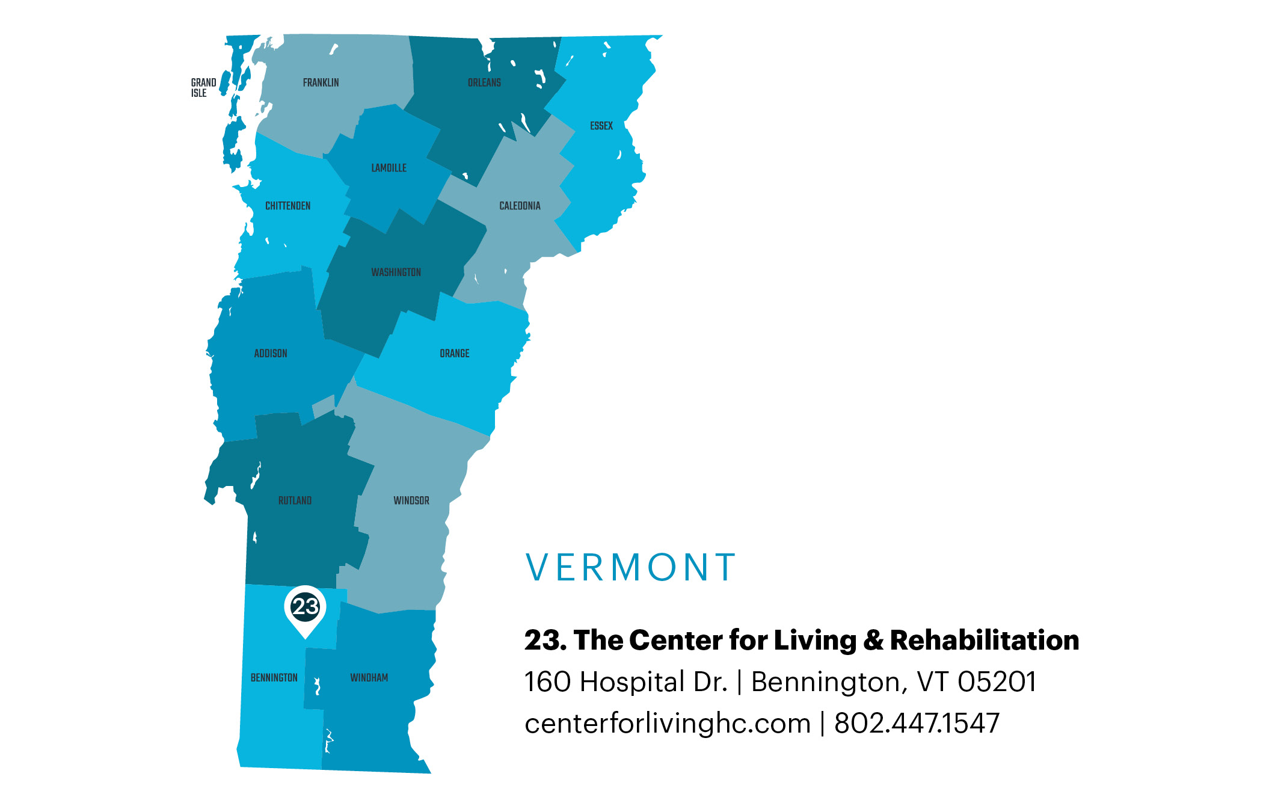
Allaire – Vermont
2025 Additions:
+ Springfield Health and Rehab
Springfield, VT
+ Saint Johnsbury Health and Rehab
Saint Johnsbury, VT
+ Rutland Center for Living and Rehab
Rutland, VT

Slide 7
Mission and Values
We strive to:
  Add value
  Embrace challenge
  Find creative solutions
  Disrupt the status quo
We expect our leaders to be:
  Drama-free
  Dependable
  Self-Motivated

Slide 8
What makes Allaire different?
Clinical Excellence & Outcomes: strong metrics, low rehospitalizations
Specialty Programs: TBI, Memory Care, Ventilator, Cardiac
Behavioral Unit: in partnership with City of Philadelphia
Resident Experience: high-touch, dignity-focused care
Proven Track Record: not-for-profit, county, hospital, and faith-based transitions
Hospital Affiliations: robust clinical partnerships for continuity of care

Slide 9






Strategic Partnerships

Slide 10
30-Day Rehospitalization 2024: avg 20.7%
ARN = Allaire Rehab and Nursing
MV = Morris View
GV = Grandview
GP = Grove Park
MPA = Morristown Post Acute
CLR = Center for Living and Rehab
SCC = Spring Creek
FV = Fallsview
CM = Claremont
RV = Riverview
LH = Lock Haven
BH = Bradford Hills
CRN = Center for Rehab and Nsg at Wash Twp
CH = Crest Haven
SR = Sunset Ridge
US avg | 24.50% |  | NJ avg | 25.80%
VT avg | 18.70% |  | PA avg | 23.50%

Slide 11
Regulatory Updates

Slide 12
The Basics:
What are the requirements of participation?
  A set of requirements that an institution must meet in order to qualify to participate as a SNF in the Medicare program, and as a nursing facility in the Medicaid program.
  The basis for survey activities for the purpose of determining whether a facility meets the requirements of participation in Medicare and Medicaid

Slide 13

August 2024: CMS Memo QSO-25-12-NH
Further revised surveyor guidance and CE pathways related to the following areas:
  Admission, Transfer, Discharge
  Sufficient Nursing Staff
  Unnecessary Medications
  Professional Standards and Medical Director
  MDS Accuracy
  QAPI
  CPR
  Pain Mgmt
  Physical Environment
  Infection Prevention
  COVID Immunization
Notes:
Phase I focused heavily on Resident Rights and updating the regs to reflect the Resident’s position at the center of his/her care. Regulatory updates included changes to the care plan process to make it more person-centered, requirements re. notification of families in the event of facility-initiated discharges, requirement for facilities to accept a resident back to a facility after an emergency transfer, equal access to care, restraint reduction, grievance process , etc.
Phase 2 focused on behavioral health – training staff in non-pharmacologic behavioral health strategies, regulating the use of PRN psychotropic meds (14-day duration, etc.) – as well as QAPI, infection control program and ABT stewardship requirement, baseline care plans, and facility assessment.
Phase 3 introduced concepts of cultural competence, trauma-informed care, identifying and acting upon changes in condition, infection preventionist requirement. Mandatory education for staff and vendors to include abuse/neglect, QAPI, IC, compliance and ethics, behavioral health, communication, resident rights.

Slide 14
Sufficient Nursing Staff, RN 8hrs/7days/wk,
Full Time DON, & PBJ
Investigation guidance added to include use of PBJ reporting
Other instructions to surveyors / investigative probes added
  Specific probing questions added for staff if facility triggers for low weekend staffing or one star staffing
Added guidance re. some facilities needing more than minimum RN coverage due to specific population needs
Specifically notes that hours worked by DNS or other RNs can contribute to meeting RN requirement of regulation.
  “The requirement for 8 consecutive hours of RN services can be met by any RN or multiples of RNs. The hours worked by the DON would be considered applicable towards this requirement.”
Notes:
Review of PBJ data is part of offsite preparation for annual survey. Look to PBJ data to determine whether facility:
Reported no RN hours (F727)
Failed to have nurse coverage 24 h/d (F725)
Reported excessively low weekend staffing (F725)
Has one star in staffing (F725)
Failed to submit PBJ data (F851)

Slide 15
IF THE FACILITY TRIGGERS FOR REPORTING NO LICENSED NURSING COVERAGE FOR 24 HRS, DURING ENTRANCE CONFERENCE, THE TC MUST INFORM THE FACILITY THAT F725 WILL BE ISSUED UNLESS EVIDENCE IS PROVIDED TO THE CONTRARY. MINIMUM SCOPE AND SEVERITY OF THIS CITATION IS F.

Slide 16
What Are the New Pennsylvania Staffing Regulations?
Above and beyond ROP, each state has a unique set of requirements that facilities must abide by. In 2023, Pennsylvania updated regulations related to staffing ratios (first update since 1997!):
  Minimum HPPD increased to 2.87 (2023), 3.2 (2024)
  C.N.A. ratios (eff. 2024) – Day Shift 1:10; Evening 1:11; Night 1:15
  LPN ratios (eff. 2023) – Day Shift 1:25; Evening 1:30; Night 1:40
  RN ratios (eff. 2023) – All Shifts 1:250
  Only direct resident care provided by nursing personnel may be counted towards the total number of hours of general nursing care
  Mandatory PBJ reporting, subject to audits
  Staffing data now publicly available
  Noncompliance subject to fines and survey citations

Slide 17
Why These Regulations Matter
Defines a new standard of care
Empowers families with transparency
Raises stakes for legal liability and compliance
Heightens expectations across the board
Attorneys and advocates must adjust due diligence accordingly

Slide 18
Why These Regulations Matter
Widespread noncompliance with new requirements
  Faulty premise of labor availability and operator choice
Most frequently cited deficiency in 2024 and 2025
Changing landscape as struggling operators have closed doors
  Fewer beds, particularly for the underserved – all SNFs need to share the burden of care
  Labor market adjustment / normalization
What does the landscape look like ahead?

Slide 19
What Elder Care Attorneys Should Know
When referring:
  Ask about staffing beyond minimums
  Confirm clinical specialties and hospital affiliations
During care planning:
  Understand how new regs impact compliance and risk
  Review PBJ and survey histories
When partnering:
  Look for providers with strong leadership and compliance culture

Slide 20
How Allaire Exceeds the Standard
Regularly exceeds PA staffing mandates
Strong internal pipeline and retention initiatives
Allaire University: Training in hospitality and clinical performance
Minimal agency usage
Backed by clinical and regional oversight teams
A culture of excellence, compliance, and patient-centered care

Slide 21

Thank You
Allaire Health Services

